Slide 1

GUDLAVALLERU ENGINEERING COLLEGE
DEPARTMENT OF INFORMATION TECHNOLOGY
IOT PROJECT PRESENTATION

Slide 2
GAS Leakage Monitoring And Alerting System For Industries
Presented by: IT_A13
Team members names with Roll num’s:
G.Keerthi – 18481A1233
P.Mithin Kumar – 19485A1208
L.Sairam – 18481A1255
D.Uday – 18481A1223
B.Raja Babu – 18481A1217

Slide 3
CONTENTS:
Introduction
Purpose of project
Existing Methods
Tools required
Block diagram
Advantages & Disadvantages
Applications
Conclusions
Reference

Slide 4
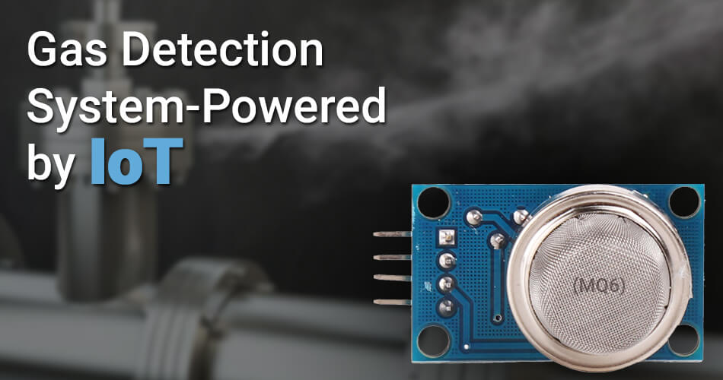
INTRODUCTON:
This project is to reduce accidents caused by the leakage of gas from the cylinders in order to reduce the adverse effects caused by the accident & also to increase the safety at places where there is a usage of cylinders.

Slide 5
PURPOSE OF PROJECT:
This device is mainly designed to monitor the gas leakage & alert through a text SMS in order to reduce the accidents.
The device can be used in industries, petrol bunks as well as for household purpose.
The main purpose of the project is safety System.
A gas leakage monitoring system can sound an alarm to operators in the area where the leak is occurring

Slide 6
EXISTING METHODS:
Humans have to check the gas level as if gas leaking or not.
It is time consuming.
If gas leaks heavily there is no chance to go and check .

Slide 7
TOOLS REQUIRED:
IBM CLOUD.
NODE RED SERVICE.
PYTHON IDLE (with Specified Packages installed).

Slide 8
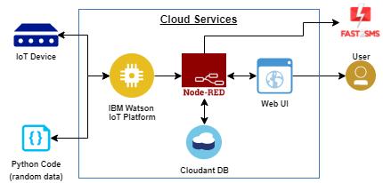
BLOCK DIAGRAM

Slide 9
Advantages:
Gas detector sense gases that humans
can’t smell.
Low power consumption.
High accuracy.
The sensor has excellent sensitivity combined with a quick response time.

Slide 10
DISADVANTAGES:
No prevention of fires possible with kit.
Applicable only as an indicator/alarming device.
Its sensitivity depends on humidity & temperature.
It cant send alert message if phone is in
switch off.

Slide 11
Applications
Home Security can be used in homes (especially kitchen) to prevent accidents due to gas leak.
Industrial Security can be used in sensitive areas to prevent any accidents.
Enhancement can be enhanced to measure specific gas levels to use in industrial applications.

Slide 12
conclusions:
In this work we have proposed an efficient autonomous system for standoff explosive detection poisonous gas.
While comparing with traditional systems have lot of advantages.
The main advantages are its miniature size, low power consumption ,distributed operation, and easy implementation.

Slide 13
Reference:
http://www.makeenenergy.com/home/knowledge-centre/the-ins-and-outs-of-gas-detection/
https://www.ijert.org/gas-leakage-detection-and-automatic-gas-booking-alert-system-using-iot

Slide 14
THANK YOU

